Slide 1
冒險故事 (Vtube Studio)

Slide 2
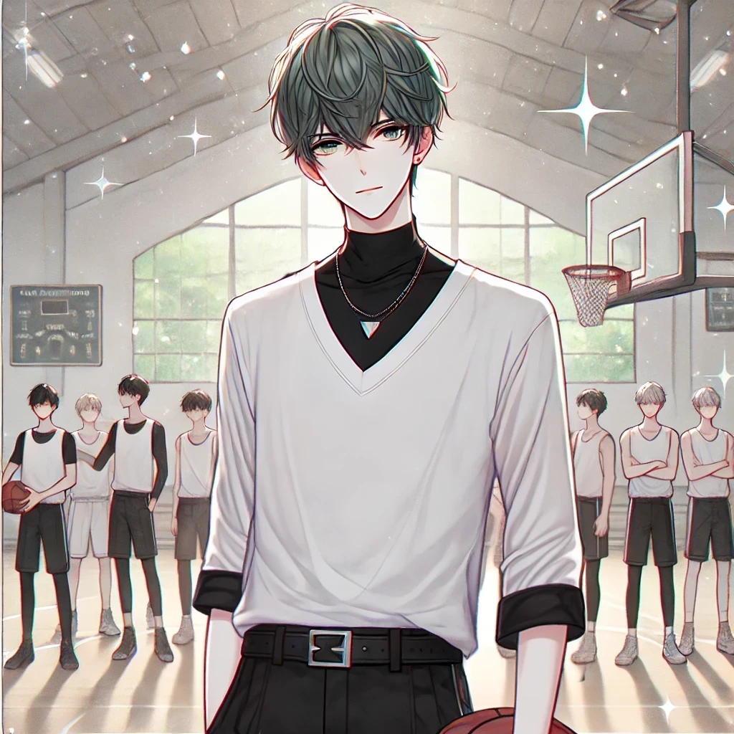
Notes:
Generate an anime-style character with a minimalist yet stylish appearance. The character is a young man with short, dark gray green, slightly tousled hair and layered bangs that partially cover his forehead. He wears a loose-fitting white long-sleeved top with a V-neck and black high-neck inner layer, adding depth to his outfit. The sleeves have black straps as additional detail. He wears black pants with a sleek, modern cut and a black belt with a metallic triangular buckle at the center. The character completes the look with black leather shoes. The background should be a soft pastel color with a few sparkles for a subtle, dreamy effect. 畫面中只要一個主角 其他人物在背景, 正方形長寬比 我想像我帶領籃球隊進入決賽並奪冠的畫面

Slide 3
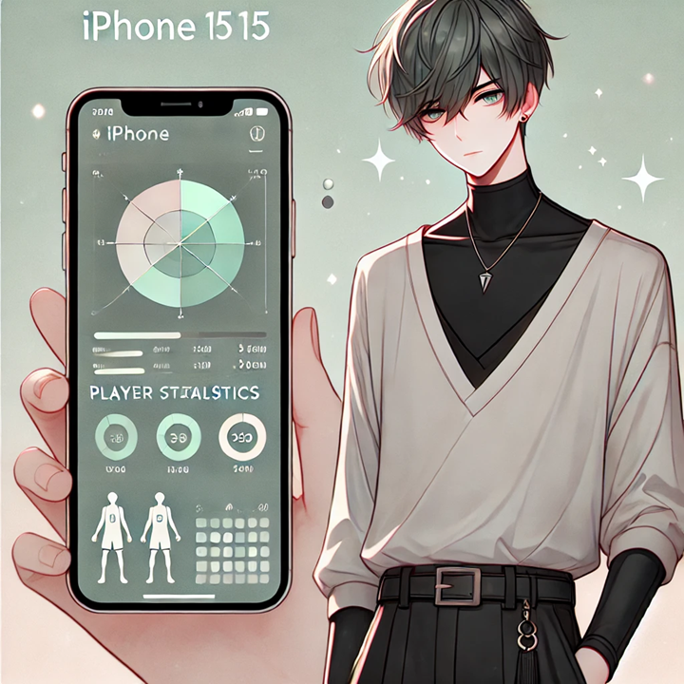
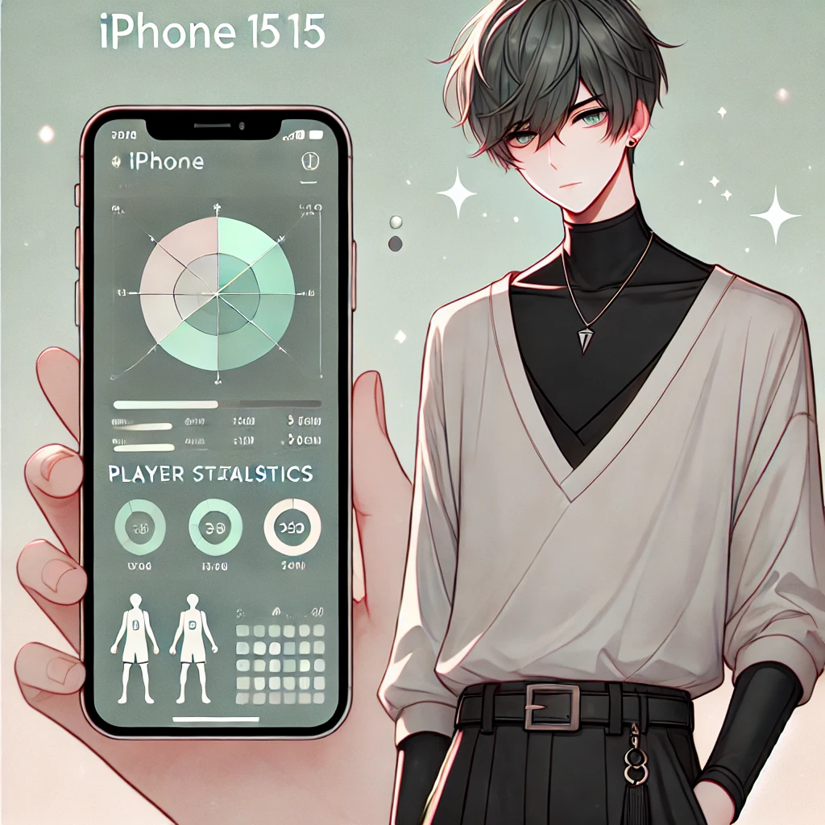
Notes:
Generate an anime-style character with a minimalist yet stylish appearance. The character is a young man with short, dark gray green, slightly tousled hair and layered bangs that partially cover his forehead. He wears a loose-fitting white long-sleeved top with a V-neck and black high-neck inner layer, adding depth to his outfit. The sleeves have black straps as additional detail. He wears black pants with a sleek, modern cut and a black belt with a metallic triangular buckle at the center. The character completes the look with black leather shoes. The background should be a soft pastel color with a few sparkles for a subtle, dreamy effect. 畫面中只要一個主角 其他人物在背景, 正方形長寬比 一款專門為我們球隊設計的數據分析應用在iphone15上呈現出來

Slide 4

Notes:
Generate an anime-style character with a minimalist yet stylish appearance. The character is a young man with short, dark gray green, slightly tousled hair and layered bangs that partially cover his forehead. He wears a loose-fitting white long-sleeved top with a V-neck and black high-neck inner layer, adding depth to his outfit. The sleeves have black straps as additional detail. He wears black pants with a sleek, modern cut and a black belt with a metallic triangular buckle at the center. The character completes the look with black leather shoes. The background should be a soft pastel color with a few sparkles for a subtle, dreamy effect. 畫面中只要一個主角 其他人物在背景, 正方形長寬比 一款專門為我們球隊設計的數據分析應用在iphone15上呈現出來

Slide 5
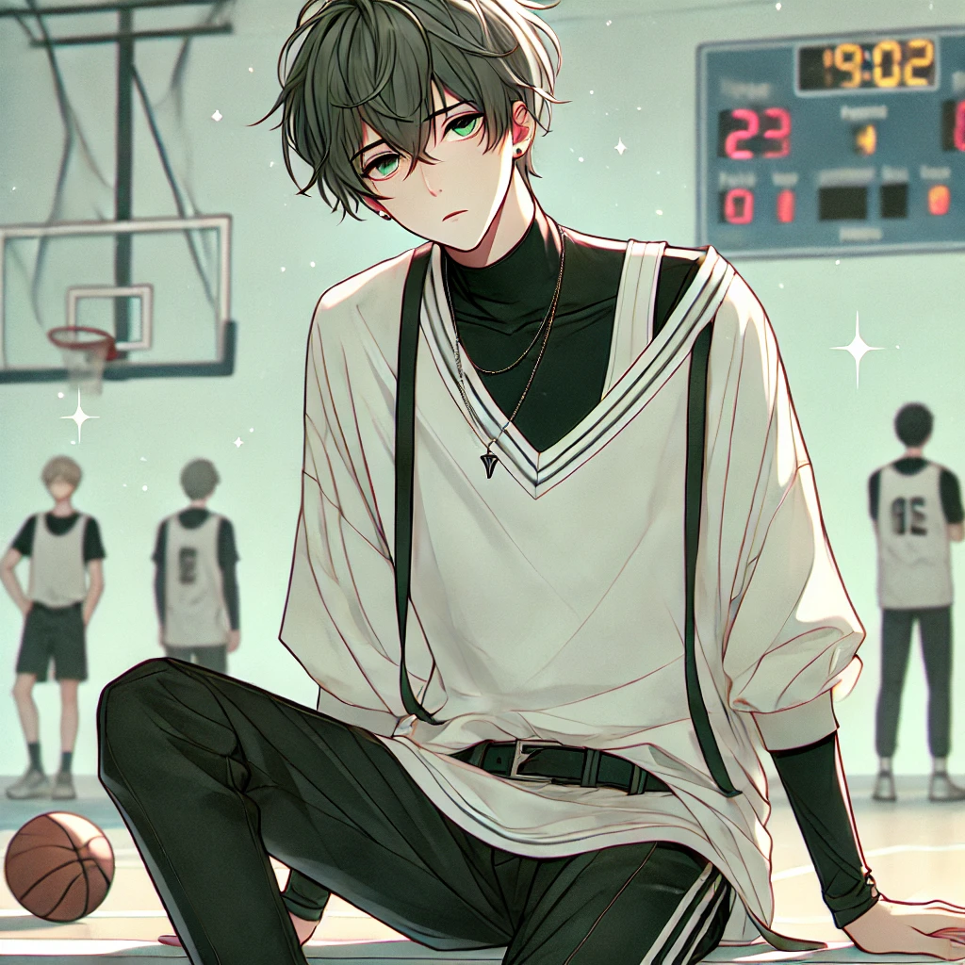
Notes:
Generate an anime-style character with a minimalist yet stylish appearance. The character is a young man with short, dark gray green, slightly tousled hair and layered bangs that partially cover his forehead. He wears a loose-fitting white long-sleeved top with a V-neck and black high-neck inner layer, adding depth to his outfit. The sleeves have black straps as additional detail. He wears black pants with a sleek, modern cut and a black belt with a metallic triangular buckle at the center. The character completes the look with black leather shoes. The background should be a soft pastel color with a few sparkles for a subtle, dreamy effect. 畫面中只要一個主角 其他人物在背景, 正方形長寬比 在籃球場上精疲力竭

Slide 6
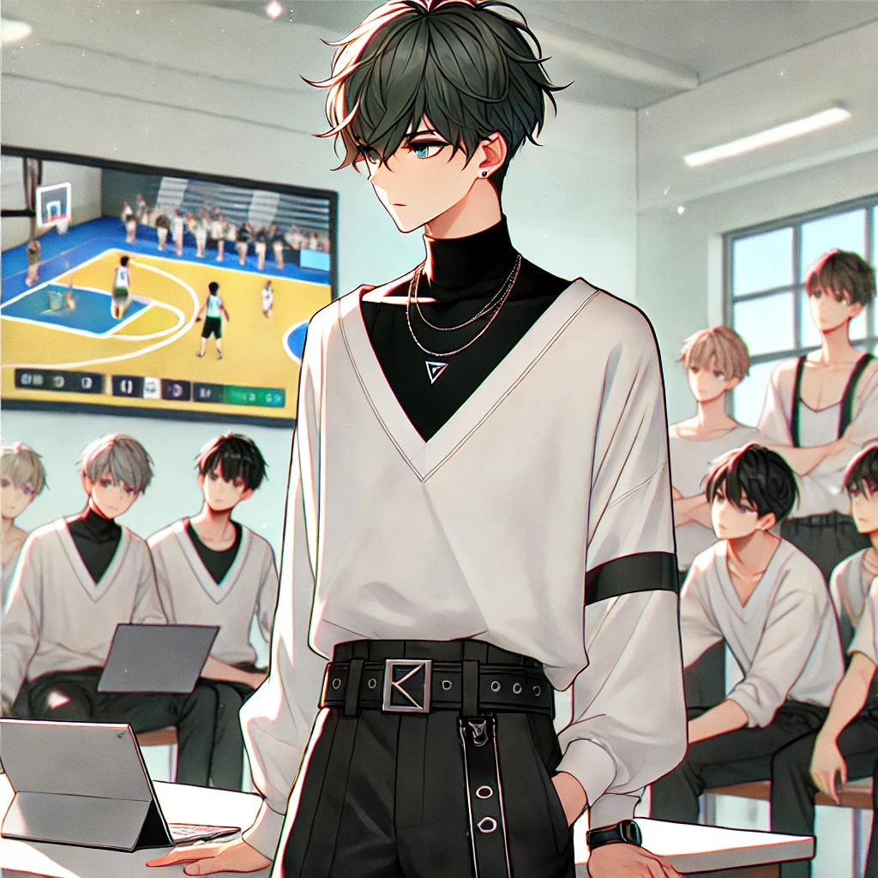
Notes:
Generate an anime-style character with a minimalist yet stylish appearance. The character is a young man with short, dark gray green, slightly tousled hair and layered bangs that partially cover his forehead. He wears a loose-fitting white long-sleeved top with a V-neck and black high-neck inner layer, adding depth to his outfit. The sleeves have black straps as additional detail. He wears black pants with a sleek, modern cut and a black belt with a metallic triangular buckle at the center. The character completes the look with black leather shoes. The background should be a soft pastel color with a few sparkles for a subtle, dreamy effect. 正方形長寬比 和隊友們一起分析比賽錄像

Slide 7
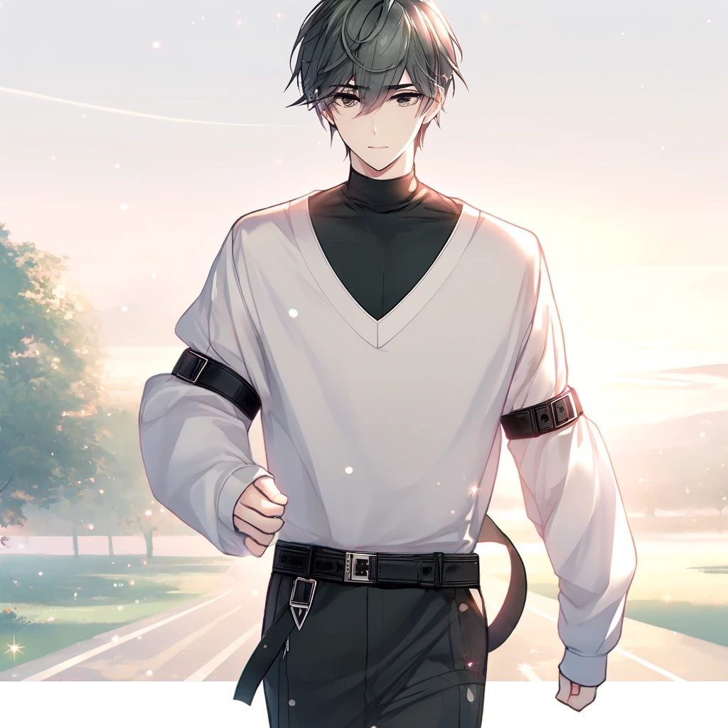
Notes:
Generate an anime-style character with a minimalist yet stylish appearance. The character is a young man with short, dark gray green, slightly tousled hair and layered bangs that partially cover his forehead. He wears a loose-fitting white long-sleeved top with a V-neck and black high-neck inner layer, adding depth to his outfit. The sleeves have black straps as additional detail. He wears black pants with a sleek, modern cut and a black belt with a metallic triangular buckle at the center. The character completes the look with black leather shoes. The background should be a soft pastel color with a few sparkles for a subtle, dreamy effect. 畫面中只要一個主角 其他人物在背景, 正方形長寬比 每天清晨跑步的圖片

Slide 8
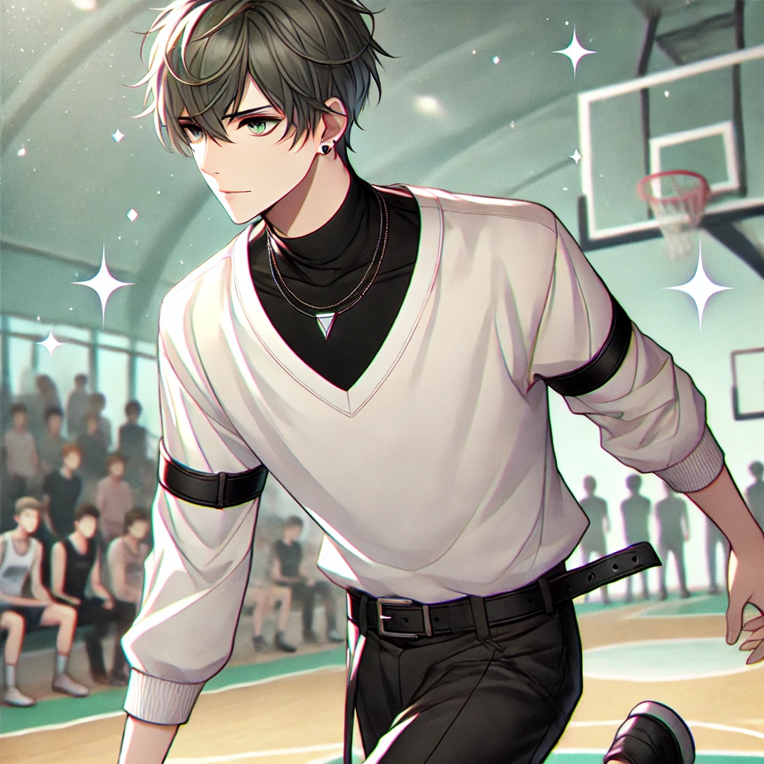
Notes:
Generate an anime-style character with a minimalist yet stylish appearance. The character is a young man with short, dark gray green, slightly tousled hair and layered bangs that partially cover his forehead. He wears a loose-fitting white long-sleeved top with a V-neck and black high-neck inner layer, adding depth to his outfit. The sleeves have black straps as additional detail. He wears black pants with a sleek, modern cut and a black belt with a metallic triangular buckle at the center. The character completes the look with black leather shoes. The background should be a soft pastel color with a few sparkles for a subtle, dreamy effect. 正方形長寬比 在籃球場上比賽的畫面

Slide 9
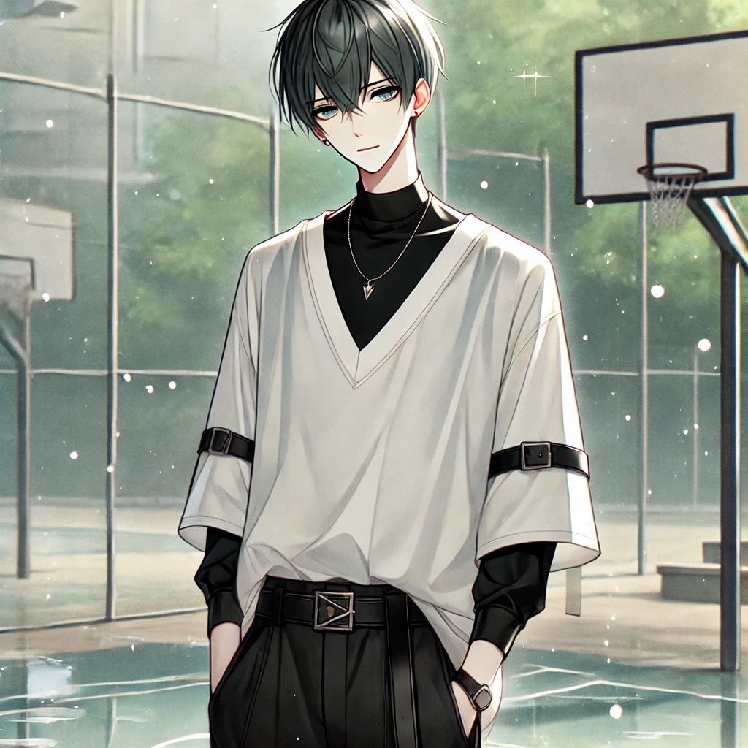
Notes:
Generate an anime-style character with a minimalist yet stylish appearance. The character is a young man with short, dark gray green, slightly tousled hair and layered bangs that partially cover his forehead. He wears a loose-fitting white long-sleeved top with a V-neck and black high-neck inner layer, adding depth to his outfit. The sleeves have black straps as additional detail. He wears black pants with a sleek, modern cut and a black belt with a metallic triangular buckle at the center. The character completes the look with black leather shoes. The background should be a soft pastel color with a few sparkles for a subtle, dreamy effect. 正方形長寬比 籃球場下雨的畫面

Slide 10
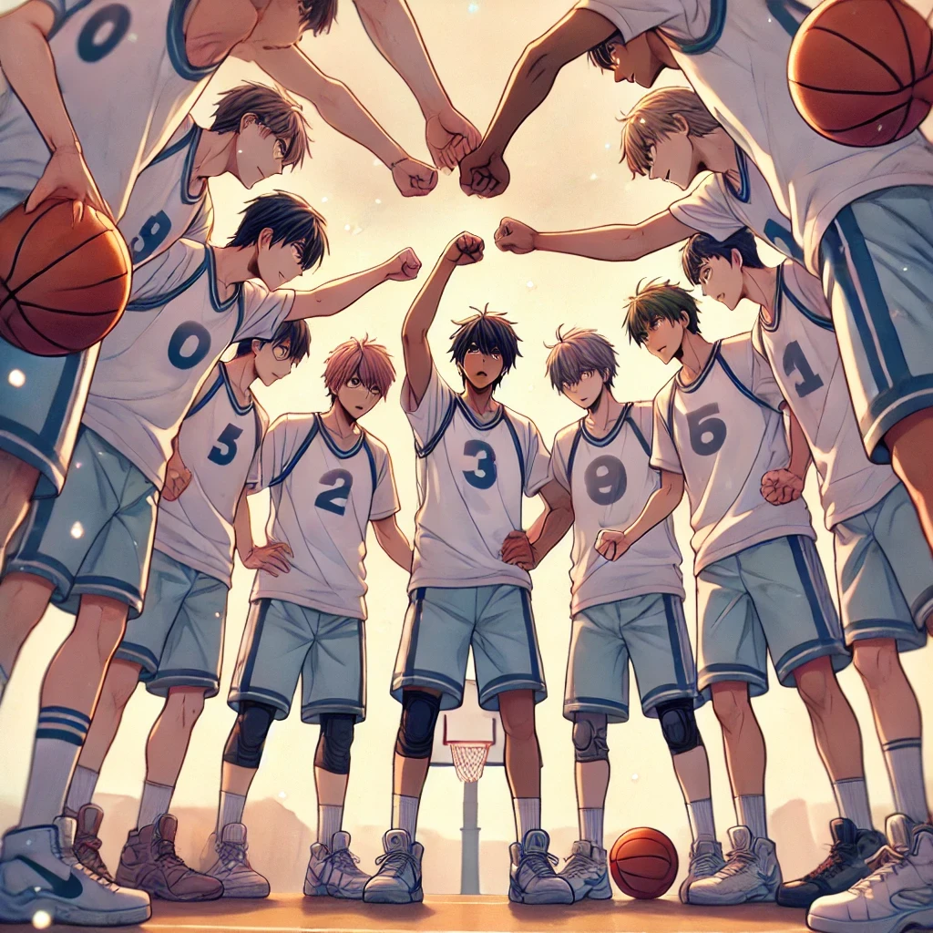
Notes:
Generate an anime-style character with a minimalist yet stylish appearance. The character is a young man with short, dark gray green, slightly tousled hair and layered bangs that partially cover his forehead. He wears a loose-fitting white long-sleeved top with a V-neck and black high-neck inner layer, adding depth to his outfit. The sleeves have black straps as additional detail. He wears black pants with a sleek, modern cut and a black belt with a metallic triangular buckle at the center. The character completes the look with black leather shoes. The background should be a soft pastel color with a few sparkles for a subtle, dreamy effect. 正方形長寬比 和隊友們一起分析比賽錄像

Slide 11
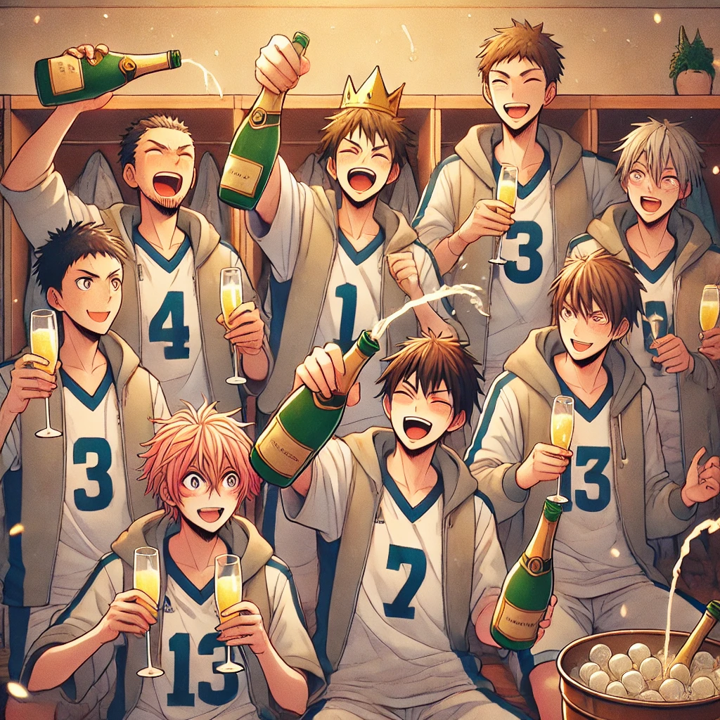
Notes:
Generate an anime-style character with a minimalist yet stylish appearance. The character is a young man with short, dark gray green, slightly tousled hair and layered bangs that partially cover his forehead. He wears a loose-fitting white long-sleeved top with a V-neck and black high-neck inner layer, adding depth to his outfit. The sleeves have black straps as additional detail. He wears black pants with a sleek, modern cut and a black belt with a metallic triangular buckle at the center. The character completes the look with black leather shoes. The background should be a soft pastel color with a few sparkles for a subtle, dreamy effect. 正方形長寬比 與隊友站上頒獎台奪得冠軍 移除主角

